Slide 1
TO-DO TASK MANAGER
A simple and minimalistic task manager to help you through the day.
.. or week
… or year

Slide 2
Features
Add, remove, and update tasks
User dashboard
Search, filter, and sort tasks
User session functionality
Label tasks with tags
Update status of tasks

Slide 3
Tech Stack
Frontend static file server based on express
Server API based on node.js and express.js
Database based on MongoDB and accessed through mongoose
JWT based authentication based on jsonwebtoken
Server monitoring based on nodemon
Code linting and styling based on eslint and prettier

Slide 4
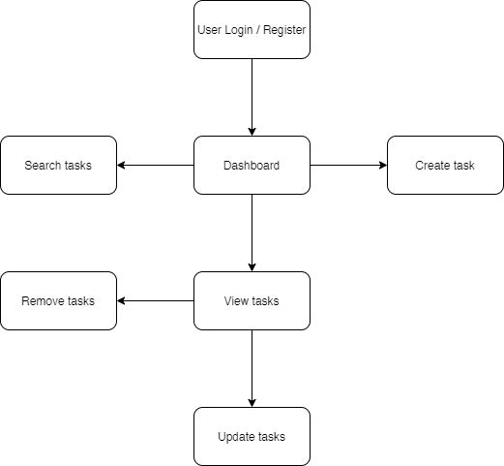
Basic Workflow

Slide 5
Tasks model
Tasks model has the following attributes in its schema
Title
Description
Due Date
Labels
Status

Slide 6
User model
User model has the following attributes in its schema
Name
Email
Password

Slide 7
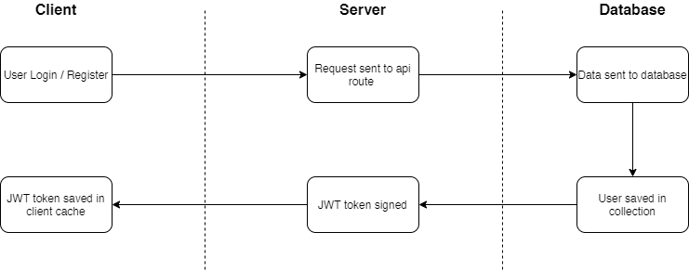
JWT Based Authentication

Slide 8
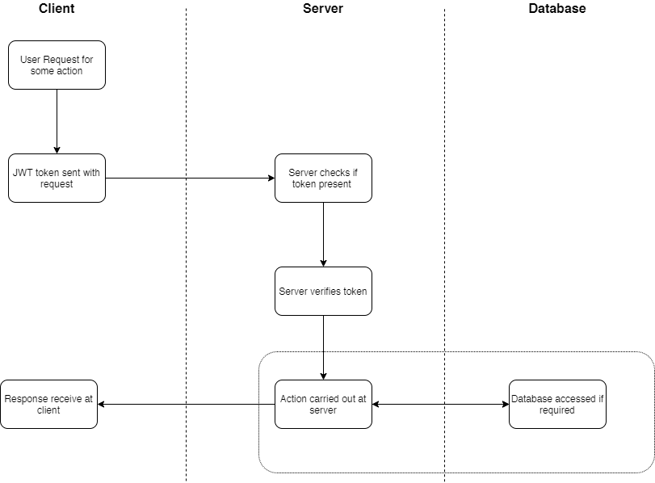
JWT Based Verification

Slide 9
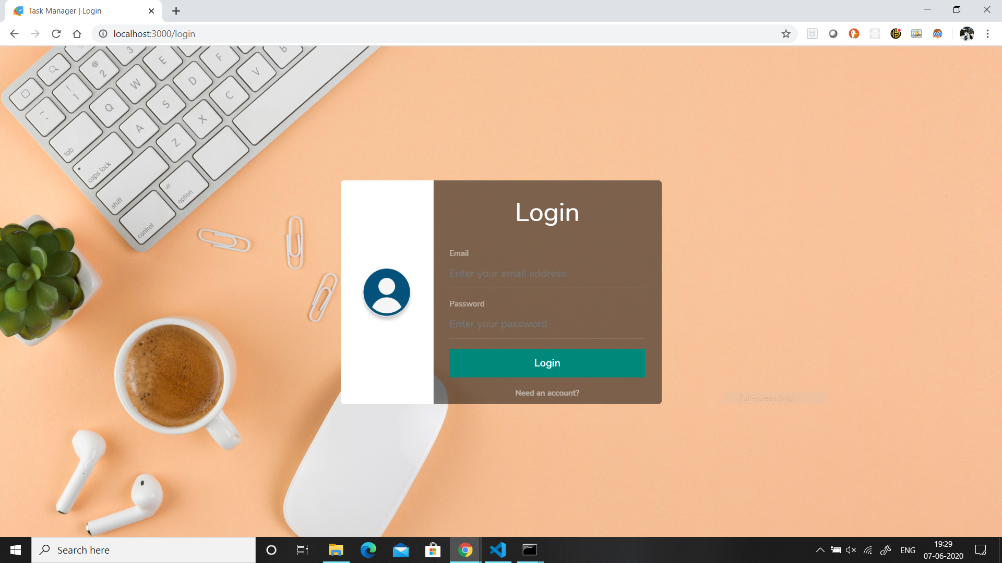
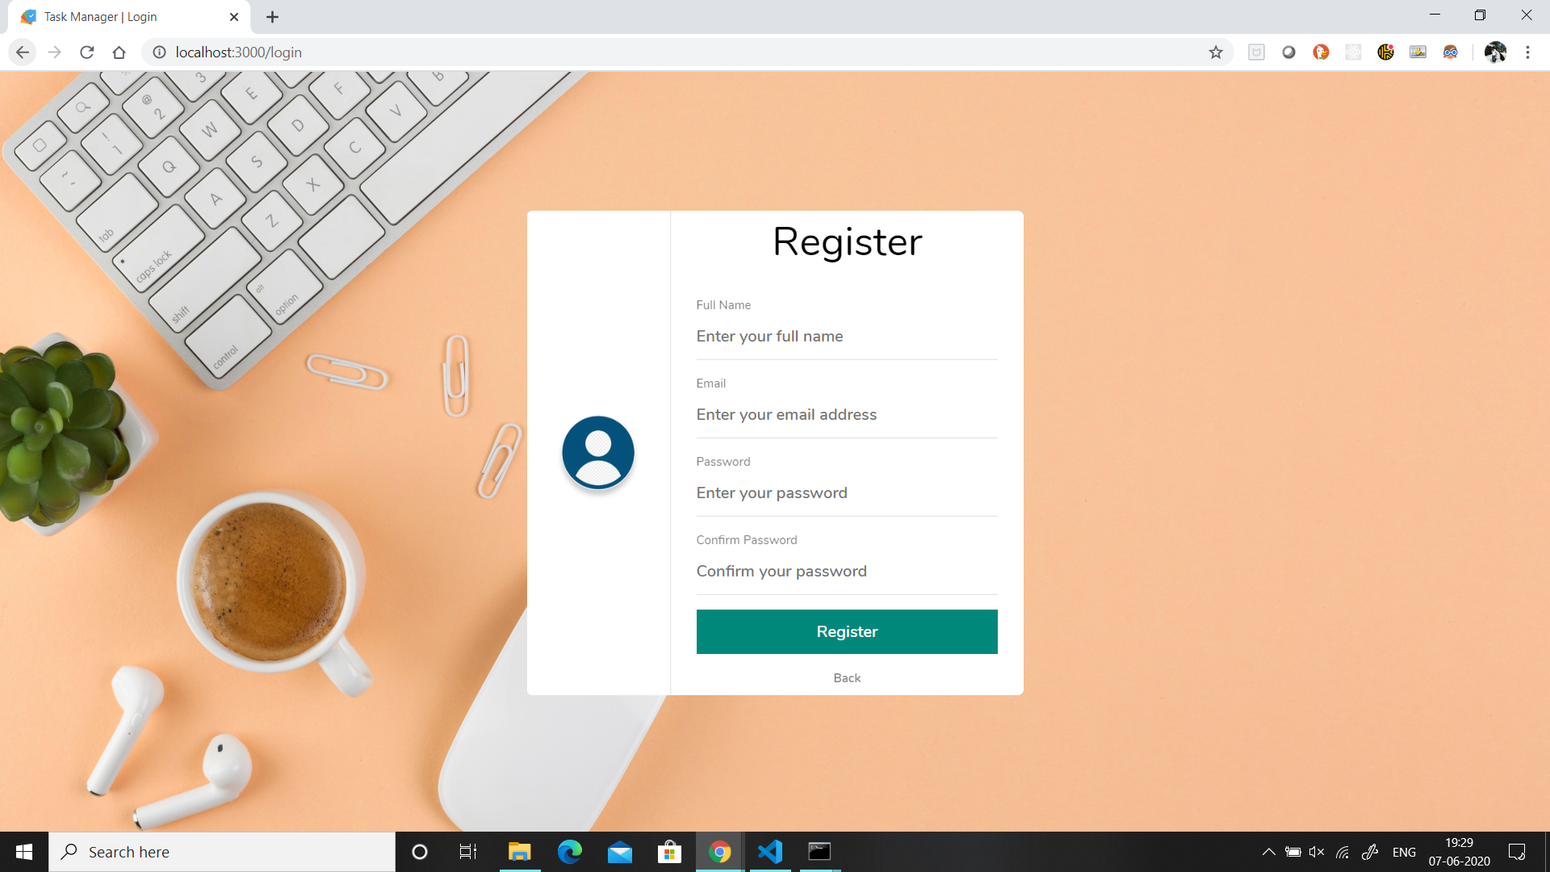
Login / Register screen

Slide 10
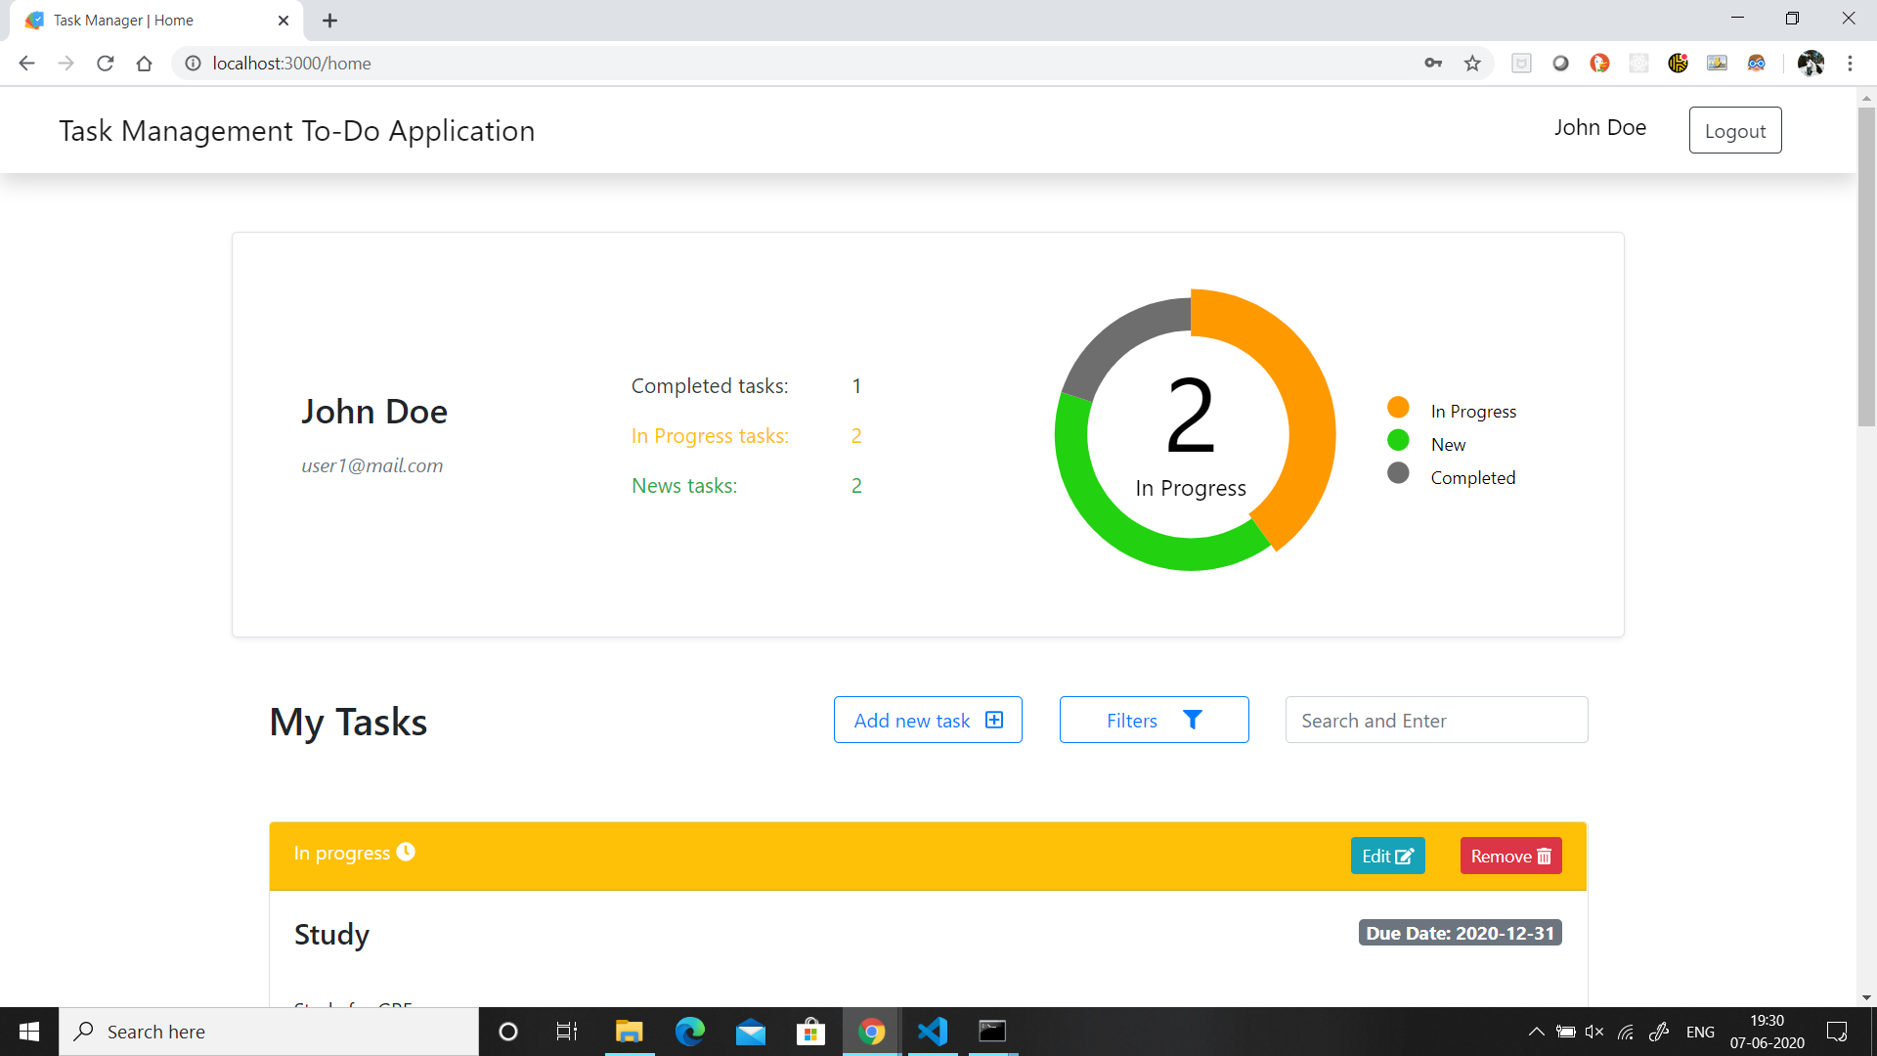
Dashboard screen

Slide 11
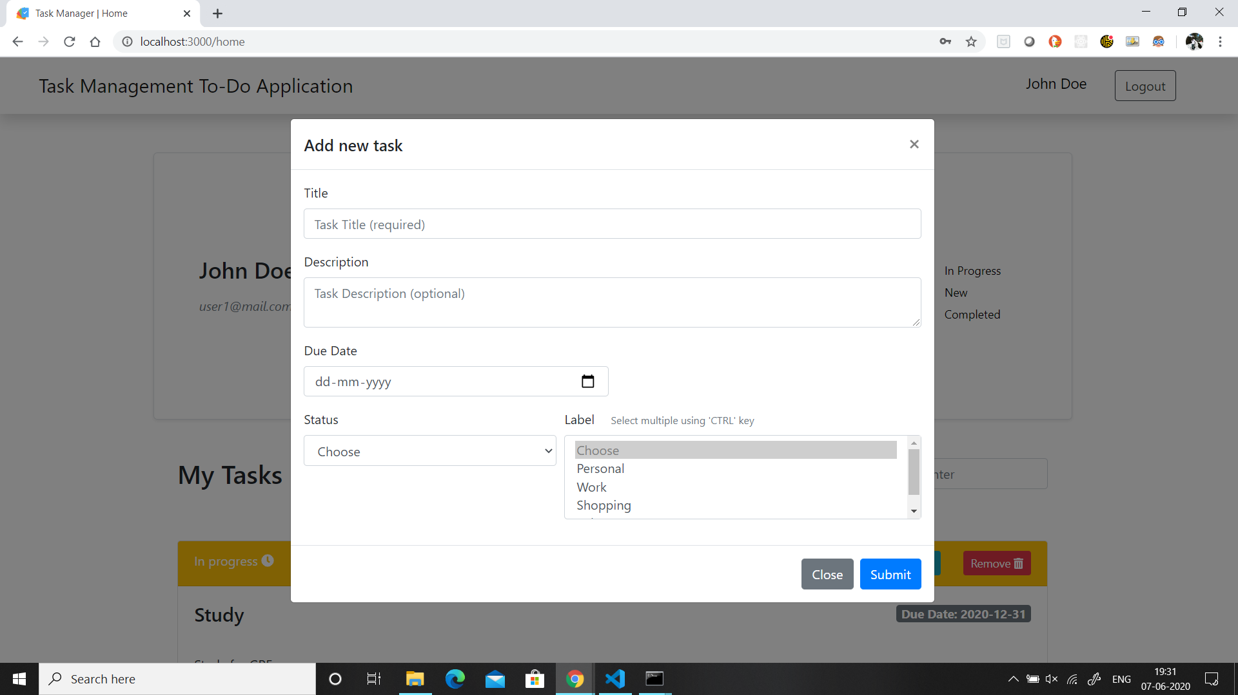
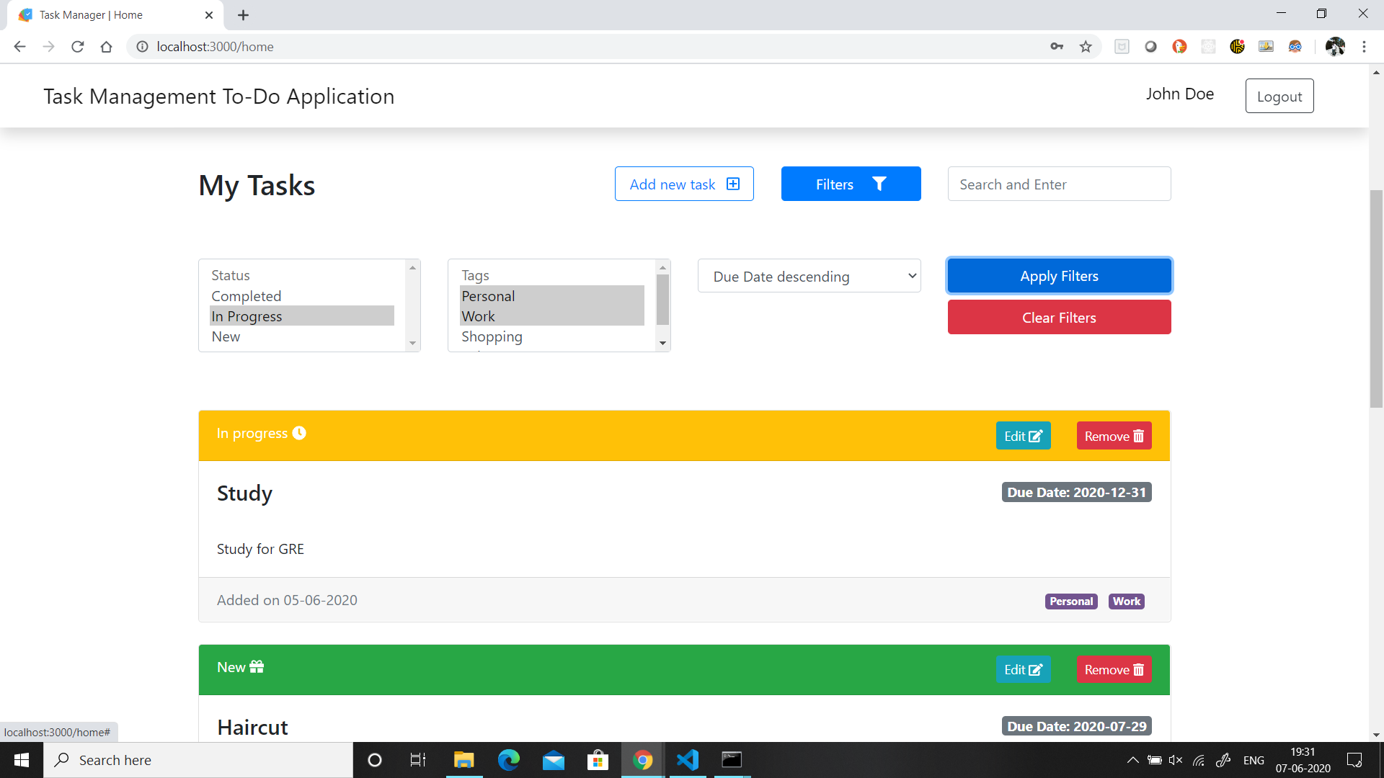
Add new task / Search tasks screen

Slide 12
Resources
Repository hosted at Github: https://github.com/Vedant1202/to-do-task-manager
Demo hosted at Heroku: https://to-do-task-manager-1299.herokuapp.com/login
Sample user details (for above Heroku link):
Email: user@mail.com
Password: 1234

Slide 13
Thank you

